Slide 1

FINAL YEAR PROJECT
ELEVATOR USING ARDUINO
Project Done By :-
1. Rounak Dipta Ghosh(1852215)
2. Diptadip Chakraborty (1852208)
3. Sujit Kumar Karar (1852219)
4. Sattwik Nandi (1852201

Slide 2
Acknowledgement:
We would like to express my sincere thanks to Mr. Rajib Ranjan Pal and Mr. Rudranath Mitra, for there valuable guidance and support in completing our project. We would also like to express my gratitude towards our electronics department and specially our Head of the Department Mr. Prabir Banerjee for giving us this great opportunity to do a project on ELEVATOR USING ARDUINO . Without their support and suggestions, this project would not have been completed. Thank You!

Slide 3
Components used and their working
Arduino UNO
LCD Display
LOAD cell
L298 motor driver
Button

Slide 4
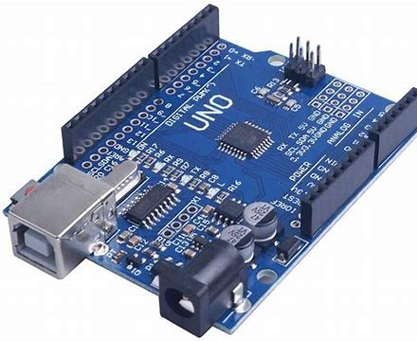
1.Arduino UNO :-
What is Arduino? Arduino is an open-source electronics platform based on easy-to-use hardware and software.

Slide 5
Why Arduino?
Thanks to its simple and accessible user experience, Arduino has been used in thousands of different projects and applications. The Arduino software is easy-to-use for beginners, yet flexible enough for advanced users.

Slide 6
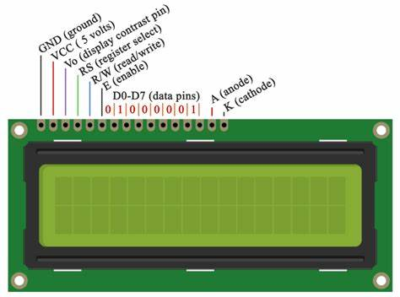
2. LCD Display
LCD stands for liquid crystal display it mostly used in different electronic projects and devices to display different values. LCD uses liquid crystals for the production of visible image.

Slide 7
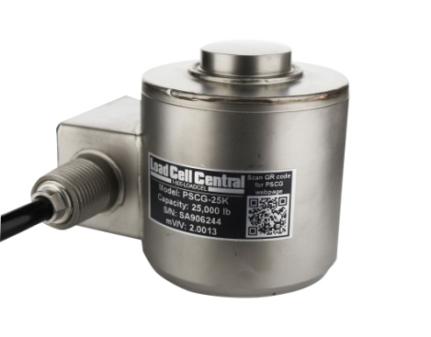
3.High Capacity Compression Load Cell - HCC
The HCC is a fully welded stainless steel canister load cell with a protection level of IP68. Rugged construction houses a high accuracy measurement element which provides better than .03% combined error.

Slide 8
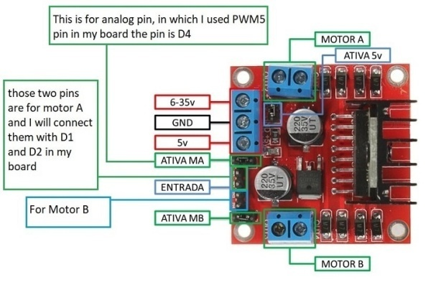
4.L298 motor driver
L298 is a high voltage and high current motor drive chip which receives TTL logic signals..
Thus, H-Bridge is basically used to control the rotating direction in DC motors.

Slide 9
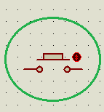
5.Button
With the help of this push buttons we can move the elevator in upward direction, downward direction or can also stop the elevator.

Slide 10
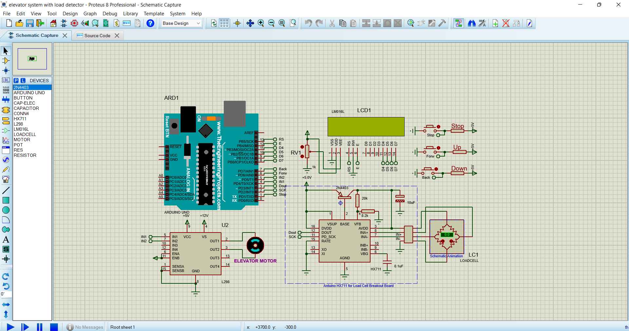
Results and Project analyzing-

Slide 11
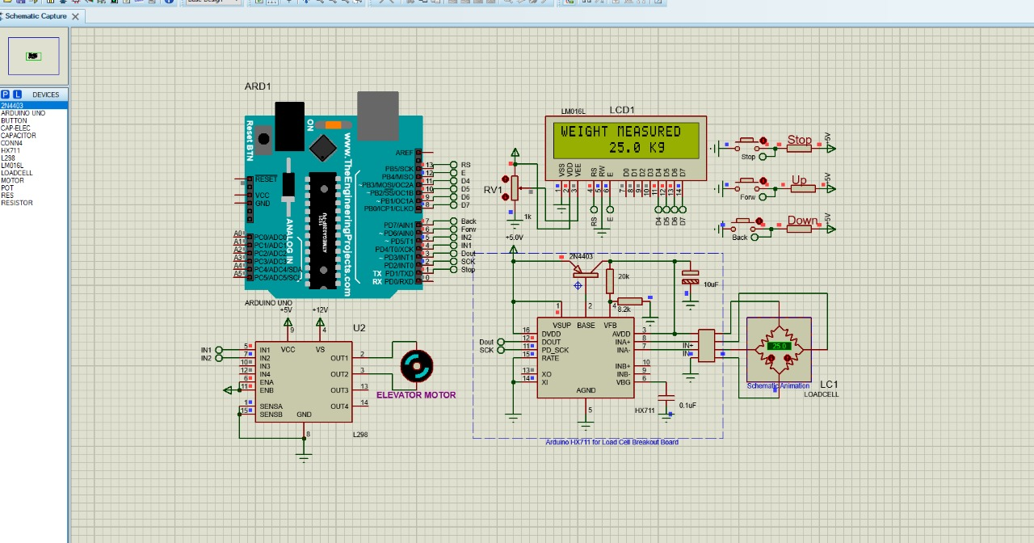
LCD displays the weight measured and the motor will start/stop with the help of the push buttons.

Slide 12
Conclusion :
The elevator design and implementation offered in this paper. Benefit of this design have been numbered with validating functionality and performance and operations. Large companies have the advantage of using these applications to perform . When we designed this system an elevator that is of very high importance in our daily lives we have learned. Design and implementation of this project showed us that development and selling of these systems to the market is not an easy work. This experience gained during the project to implement different systems, increased our motivation.With this project we gathered the knowledge about the working of an elevator and also the use of the components.

Slide 13
Thank You

